Slide 2
Business Continuity vs. Disaster Recovery
Business Continuity (BC) processes and procedures used to make sure that regular business operations continue during a disaster.
Disaster Recovery (DR) designed to prevent or minimize data loss and business disruption resulting from catastrophic events.
Business Continuity Planning (BCP) ensures that all areas will be able to maintain essential operations or be able to resume them as quickly as possible in the event of a crisis or emergency.
Disaster Recovery Planning (DRP) the subset of BCP that focuses on recovering IT infrastructure and systems.
Notes:
Stored Procedures

Slide 3
What is the Business Impact Analysis (BIA) ?
“Correlate the system with the critical mission/business processes and services provided, and based on that information, characterize the consequences of a disruption.” (* NIST SP800-34R1 (page 15))
Goals:
Determine Criticality
Estimate Maximum Downtime
Evaluate Internal / External Resource Requirements
Notes:
Stored Procedures

Slide 4
What is the Business Impact Analysis (BIA) Process ?
Step 1: Gather requirements/information
Step 2: Vulnerability assessment
Step 3: Risk Analysis
Quantitative - ALE = SLE * ARO ===> ALE = (AV*EF) * ARO
Qualitative
Step 4: Communicate Results
Notes:
Stored Procedures

Slide 5
How do we Determine Downtime?
Maximum Allowable Downtime (MAD) / Maximum Tolerable Downtime (MTD)
Recovery Time Objective (RTO)
Work Recovery Time (WRT)
Recovery Point Objective (RPO)
Notes:
Stored Procedures

Slide 6
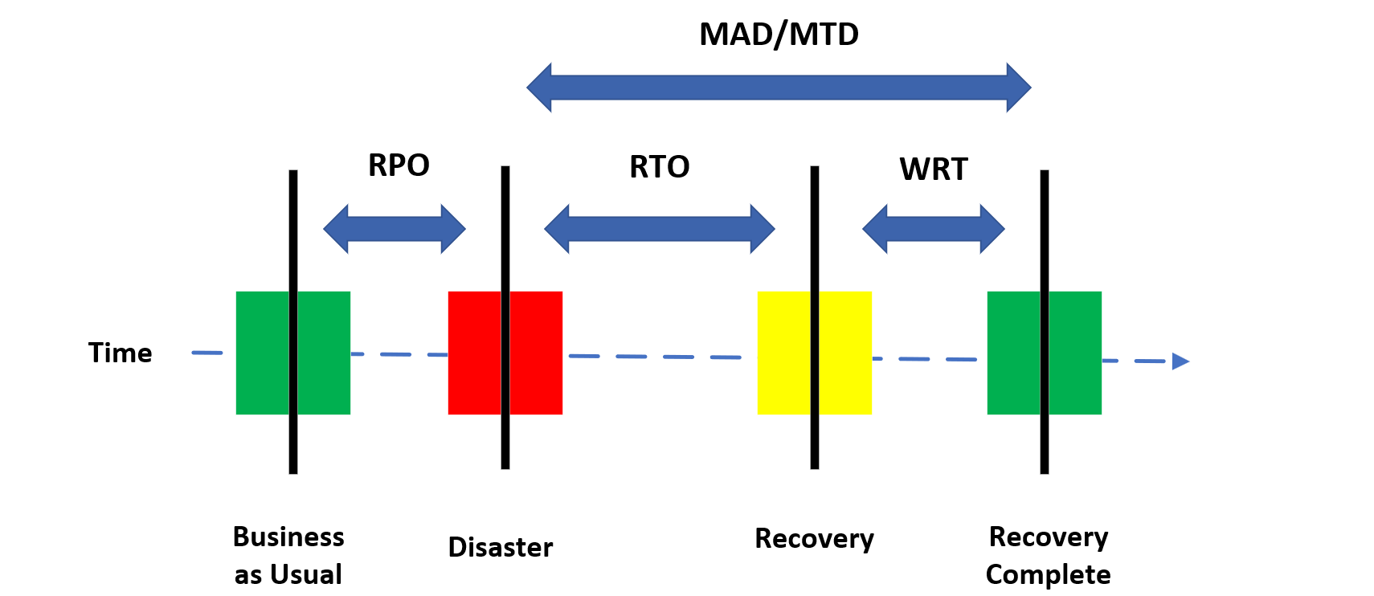
How do we Determine Downtime?
Notes:
Stored Procedures

Slide 7
Odds & Ends…
Mean time to repair (MTTR)
Mean time between failures (MTBF)
Single point of failure (SPOF)
Mission essential functions – the limited set of functions that must be continued throughout or resumed rapidly after a disruption of normal activities
Notes:
Stored Procedures

